Slide 1

Vel Tech Rangarajan Dr. Sagunthala R&D Institute of Science and Technology
School of Computing
Department of Computer Science and Engineering
10211CS224 / FULL STACK APPLICATION DEVELOPMENT (JAVA)
END SEMESTER PROJECT REVIEW
Date: 06-05-2026
SMART CAMPUS EVENT MANAGEMENT SYSTEM
SDG: SDG No - SDG4 – Quality Education
Presented By:
BINGAMALLA HANVITHA – VTU25643– 23UECS1026
Courses Handling Faculty:
Dr. S. HEMAMALINI, M.E., Ph.D.
Assistant Professor

Slide 2
INTRODUCTION
Smart Campus Event Management System is a web-based application for managing college events
Provides a centralized platform for students and administrators
Students can:
Register online
Track their participation
Admins can:
Add, edit, and delete events
Manage event details
View upcoming events
View registration statistics
Reduces manual work and improves event coordination
Built using:
Spring Boot, Spring MVC
Spring Data JPA
Thymeleaf, HTML, CSS
Ensures secure, scalable, and user-friendly system
Supports United Nations SDG 4 – Quality Education
1
2
3
4
5
6
7
8
9

Slide 3
PROBLEM STATEMENT
1
In many educational institutions, campus events such as workshops, seminars, and technical programs are managed using manual methods or fragmented digital platforms.
Students often face challenges in registering for events and tracking their participation, leading to reduced engagement.
Administrators encounter issues in efficiently managing event details, handling registrations, and maintaining records.
The absence of a centralized platform results in:
Ineffective communication
Increased chances of errors and data inconsistency
Difficulty in monitoring and analyzing event performance
Additionally, there is no streamlined way to generate insights such as registration statistics or event success metrics.
This lack of a unified system creates difficulties for students in accessing accurate, timely, and organized event information.
Therefore, there is a need for a centralized, automated, and user-friendly system that simplifies event management and enhances student participation.
2
3
4
5
6
7
8
9

Slide 4
OBJECTIVE(S)
Enable students to view and register for events easily
Provide admins with tools to create, update, and delete events
Improve communication and participation in campus activities
Ensure a secure and user-friendly platform
Support United Nations SDG 4 – Quality Education
Develop a centralized system to manage campus events
1
2
3
4
5
6
7
8
9

Slide 5
PROPOSED SYSTEM
1
Provides a real-time event dashboard showing upcoming and trending events
Introduces a role-based system with separate access for students and administrators
Implements automated registration handling, reducing delays and manual errors
Supports event capacity management (limit number of participants)
Enables feedback collection after events to improve future planning
Includes notification features (alerts/reminders for registered events)
Offers data analytics such as participation trends and popular event categories
Ensures scalability, allowing the system to handle increasing users and events
Designed with a responsive interface, making it accessible on mobile and desktop
2
3
4
5
6
7
8
9

Slide 6
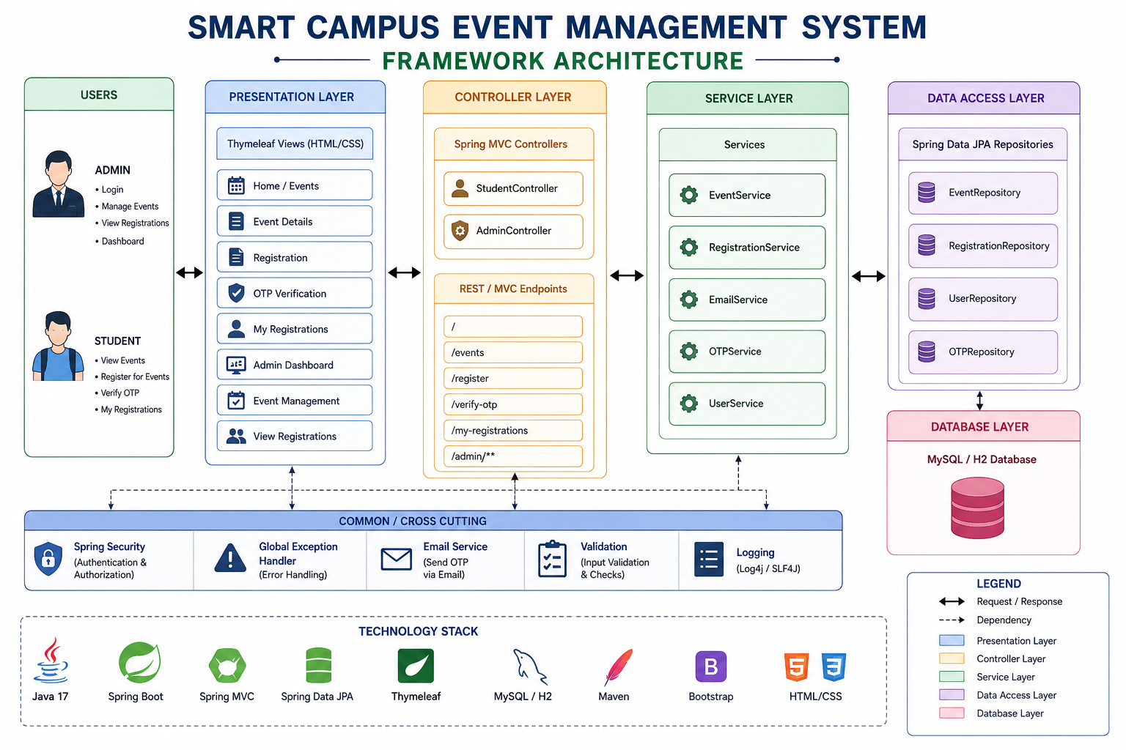
PROPOSED SYSTEM ARCHITECTURE
1
2
3
4
5
6
7
8
9

Slide 7
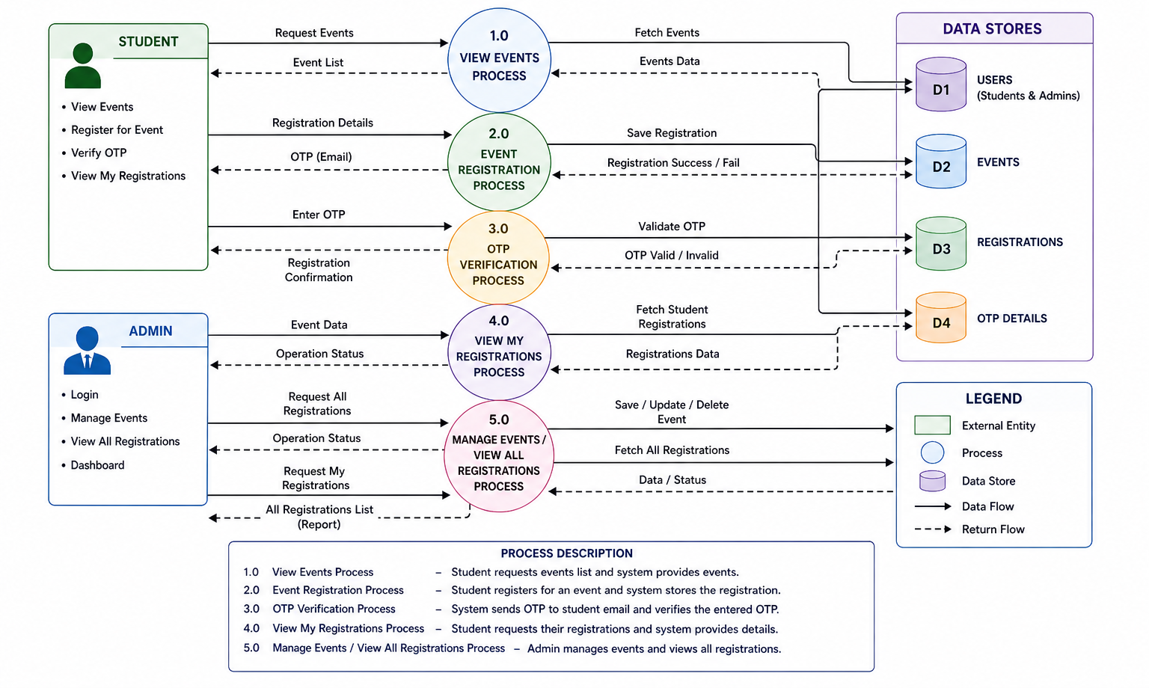
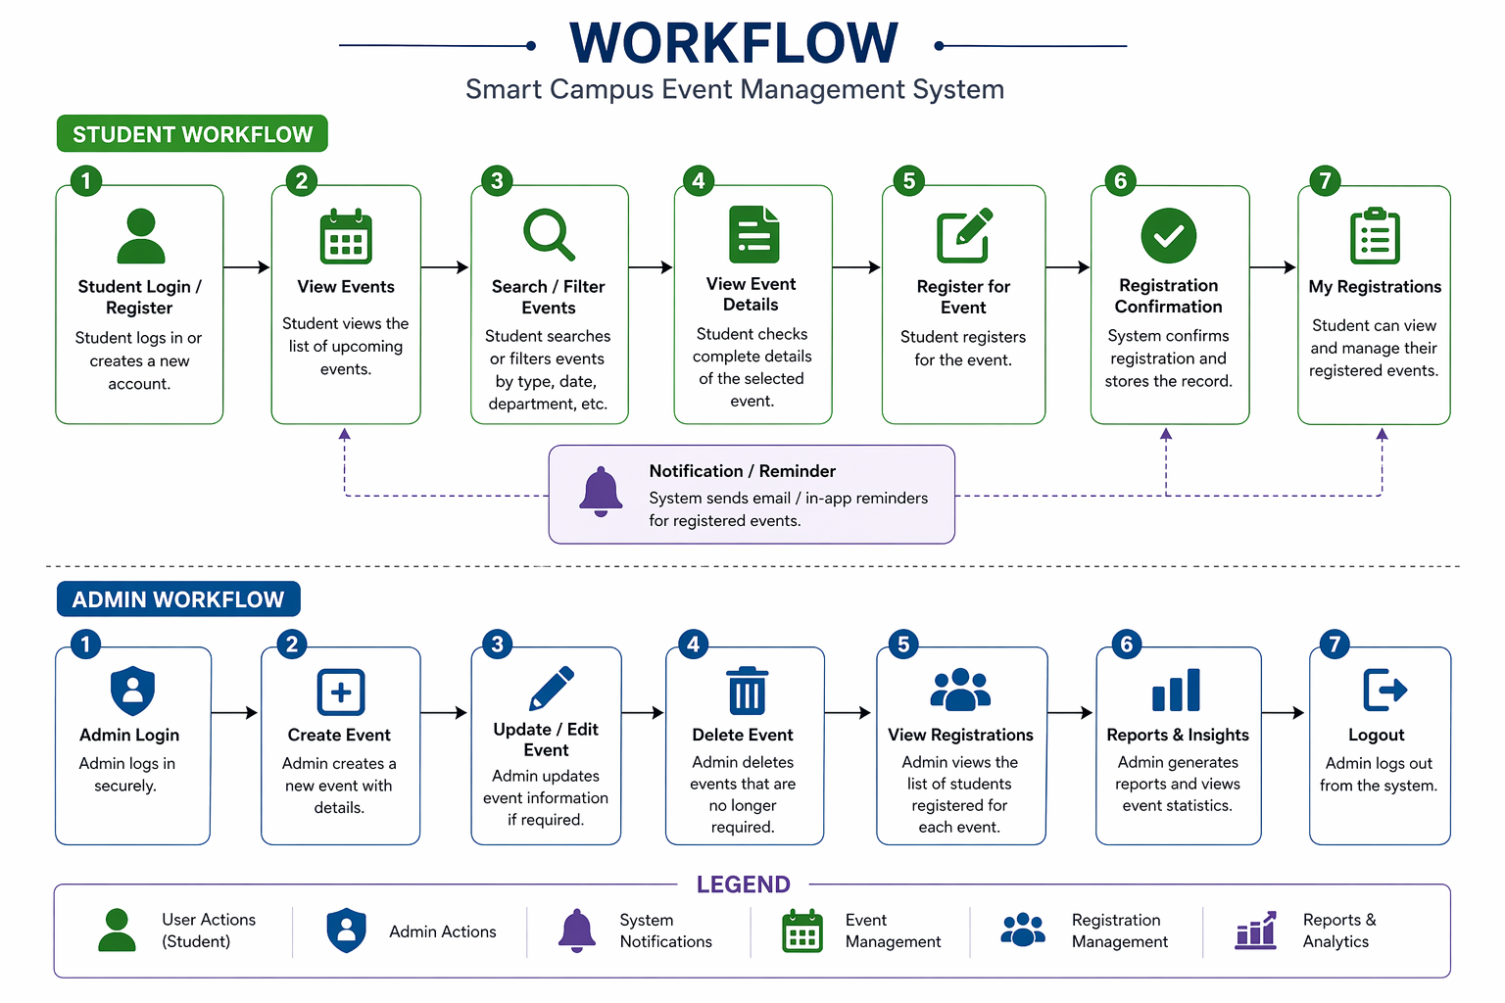
WORKFLOW
1
2
3
4
5
6
7
8
9

Slide 8
TECHNOLOGIES USED
1
Frontend: HTML5, CSS3, Thymeleaf, Bootstrap
Database: MySQL
Backend: Java, Spring Boot, Spring MVC
ORM Framework: Spring Data JPA (Hibernate)
Security: Spring Security (Basic Authentication)
Build Tool: Maven
Server: Embedded Tomcat Server
Tools/IDE: Visual Studio Code
2
3
4
5
6
7
8
9

Slide 9
MODULE DESCRIPTION
1
Module 1: Student Module
Browse and search events
Register for events
View registered events
Receive notifications/reminders
Module 2: Admin Module
Secure login and authentication
Add, update, delete events (CRUD)
Manage event details and registrations
View reports and analytics
2
3
4
5
6
7
8
9

Slide 10
MODULE DESCRIPTION
1
Module 3: Event Management Module
Create and manage event data
Search and filter events (date, type, department)
Handle event capacity and details
Module 4: Database & Security Module
Store event, student, and registration data
Ensure data consistency and integrity
Provide authentication and authorization
Secure system access
2
3
4
5
6
7
8
9

Slide 11
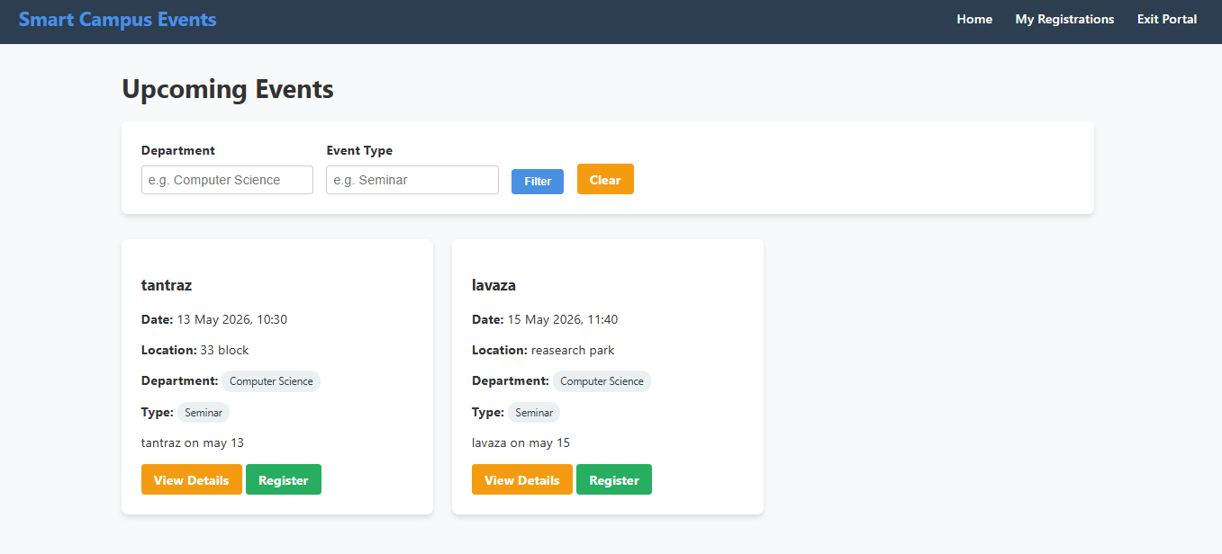
IMPLEMENTATION SCREENSHOTS
Home Page
1
2
3
4
5
6
7
8(A)
9
The Home page displays the list of upcoming events available inthe Smart Campus Event Management System.
It allows users to view event detailssuch as event name, date, location, and status, and provides options to manage events.

Slide 12
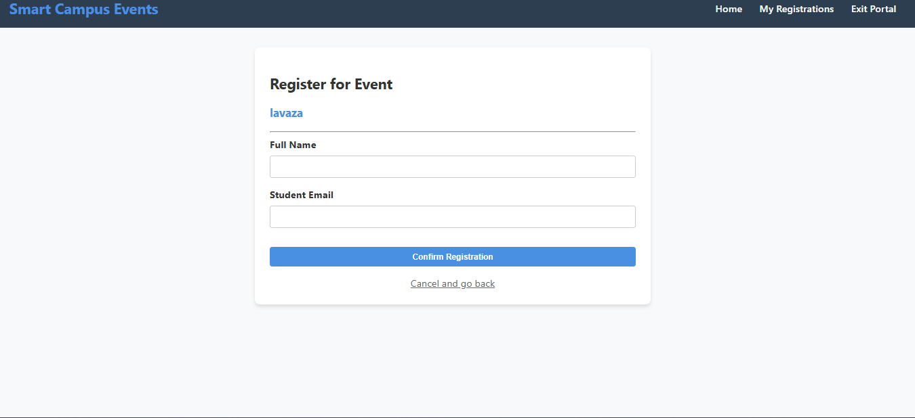
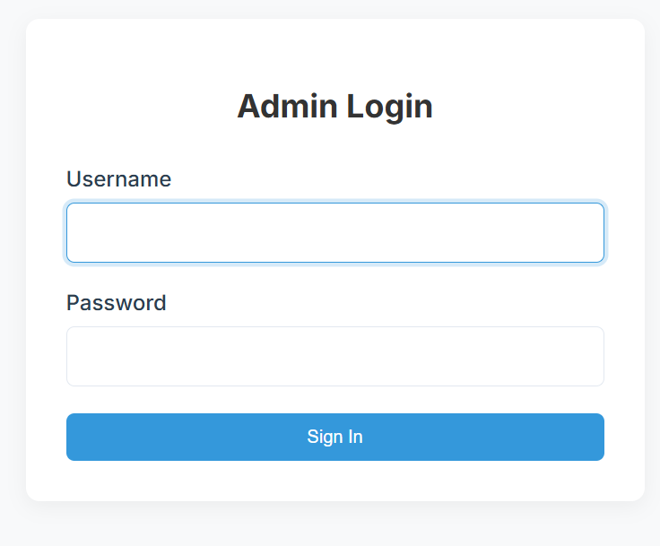
IMPLEMENTATION SCREENSHOTS
Admin Login Page
1
2
3
4
5
6
7
8(B)
9

Slide 13
IMPLEMENTATION SCREENSHOTS
Admin Login Page
The administrator is required to enter valid login credentials to access the system.
Proper validation is implemented to ensure that both fields are not empty and thatthe entered details match the records stored in the database
1
2
3
4
5
6
7
8(B)
9

Slide 14
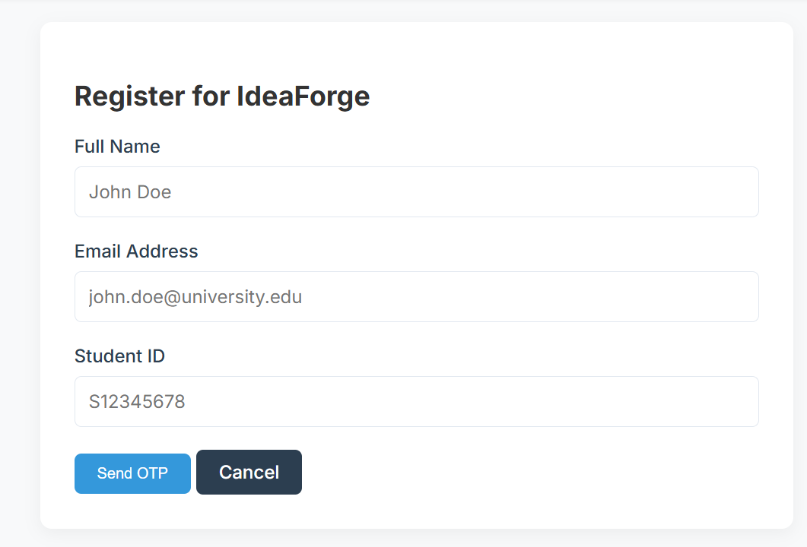
IMPLEMENTATION SCREENSHOTS
User Login Page
1
2
3
4
5
6
7
8(B)
9

Slide 15
IMPLEMENTATION SCREENSHOTS
User Login Page
The page consists of input fields including Full Name, Email Ad-dress, and Student ID.
These fields are used to uniquely identify the participant andensure proper communication.
1
2
3
4
5
6
7
8(B)
9

Slide 16
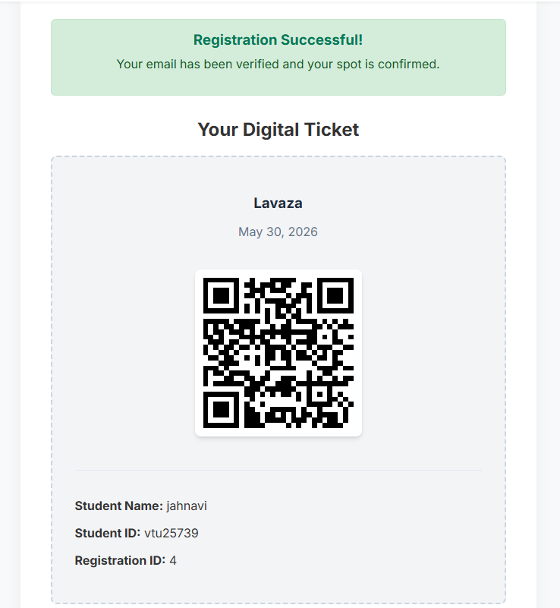
IMPLEMENTATION SCREENSHOTS
Module 1 Screenshot
1
2
3
4
5
6
7
8(C)
9

Slide 17
IMPLEMENTATION SCREENSHOTS
Module 1 Explanation
This page shows that the event registration is successful.
It confirms that the user's email has been verified and the seat has been booked.It also displays a digital ticket for the event, including the event name, date, and a QR code.
The QR code can be used for entry or verification at the event.
Additionally, the page contains student details such as name, student ID, and registration ID for identification purposes.
1
2
3
4
5
6
7
8(C)
9

Slide 18
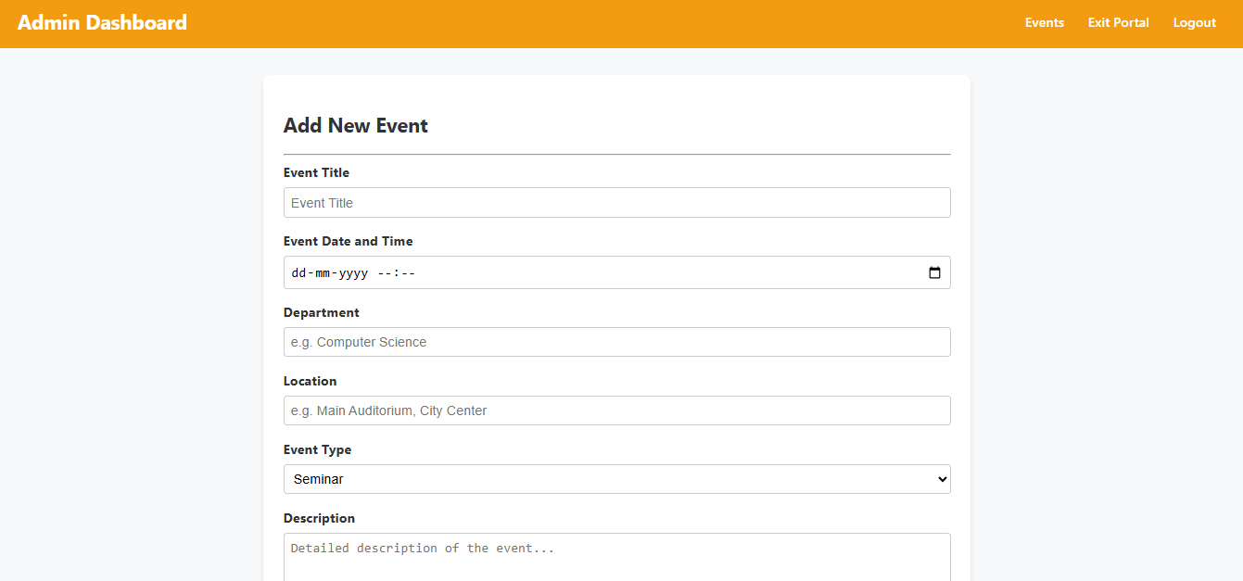
IMPLEMENTATION SCREENSHOTS
Module 2 Screenshot
1
2
3
4
5
6
7
8(C)
9

Slide 19
IMPLEMENTATION SCREENSHOTS
1
Module 2 Explanation
The Add Event page allows users to create and add new event details in the Smart Campus Event Management System.
It collects information such as event name, date, location, and status, which are stored in the database for event management.
2
3
4
5
6
7
8(C)
9

Slide 20
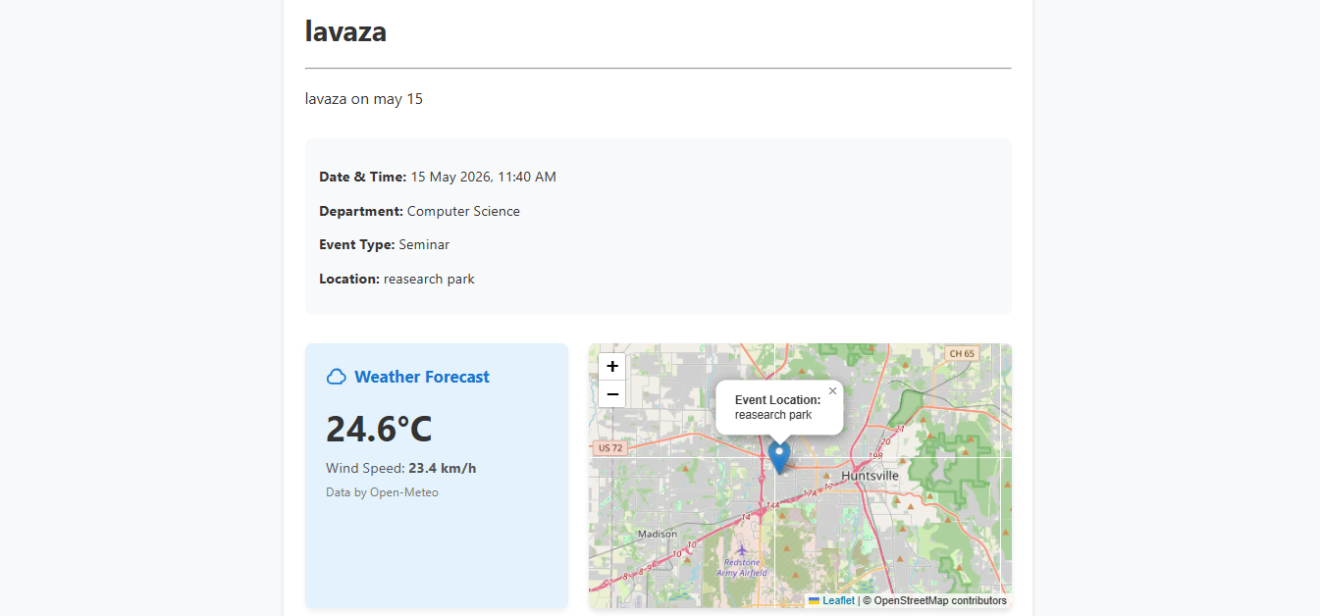
IMPLEMENTATION SCREENSHOTS
Innovative Module Screenshot
1
2
3
4
5
6
7
8(C)
9

Slide 21
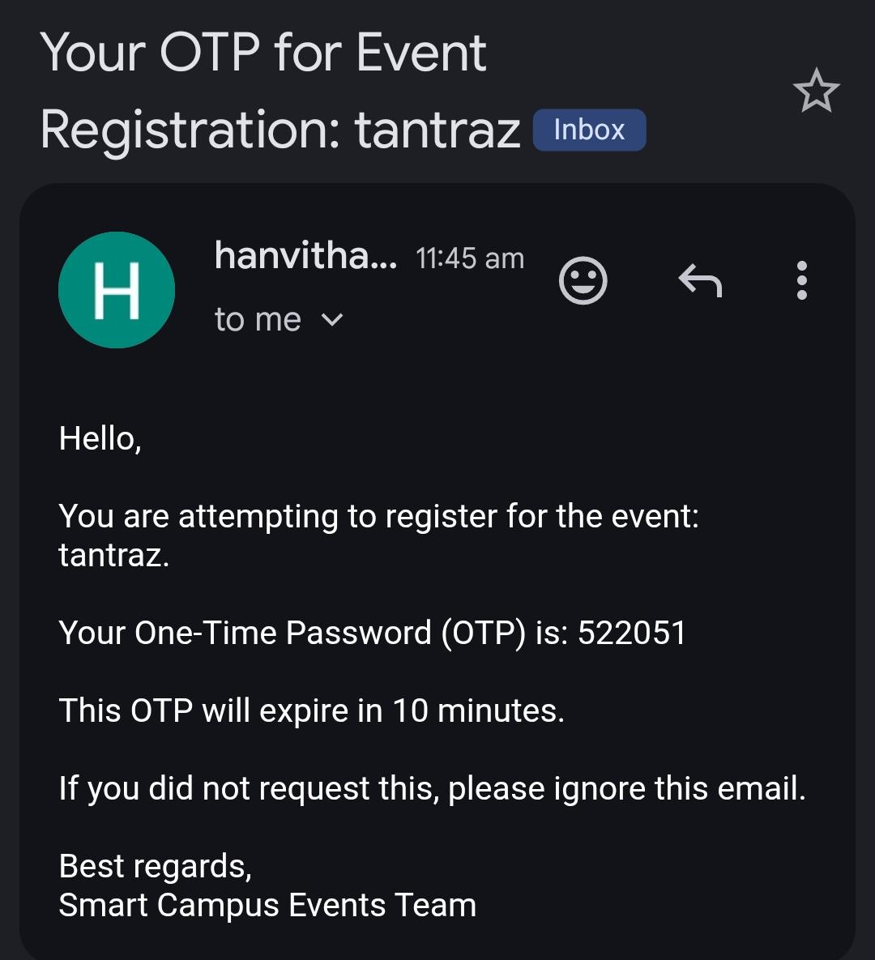
IMPLEMENTATION SCREENSHOTS
Innovative Module Screenshot
1
2
3
4
5
6
7
8(C)
9

Slide 22
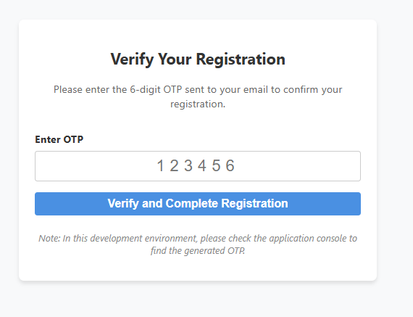
IMPLEMENTATION SCREENSHOTS
Innovative Module Screenshot
1
2
3
4
5
6
7
8(C)
9

Slide 23
IMPLEMENTATION SCREENSHOTS
1
Innovative Module Explanation
The system incorporates several advanced features to enhance security and user experience.
An OTP (One-Time Password) verification mechanism is implemented to ensure that only genuine users can register for events, reducing the chances of fake registrations.
The OTP is securely sent to the user’s email, adding an extra layer of authentication.
Additionally, location-based functionality is integrated to provide users with event venue details and improve accessibility.
Together, these features make the system more secure, reliable, and user-friendly while offering a smarter event management experience.
2
3
4
5
6
7
8(C)
9

Slide 24
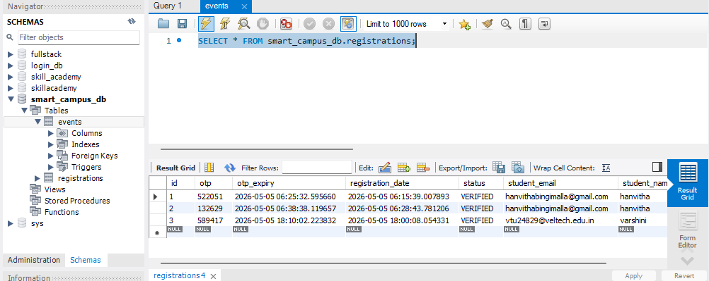
IMPLEMENTATION SCREENSHOTS
Database Screenshot
1
2
3
4
5
6
7
8(C)
9

Slide 25
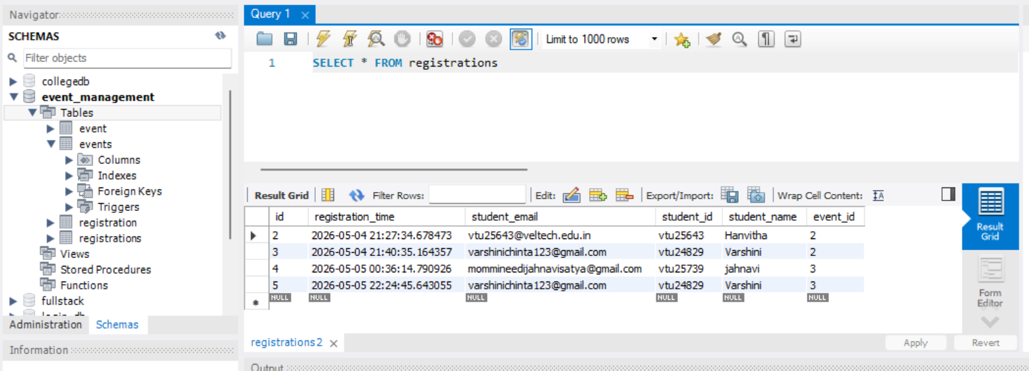
IMPLEMENTATION SCREENSHOTS
Database Screenshot
1
2
3
4
5
6
7
8(C)
9

Slide 26
ADVANTAGES & LIMITATIONS
1
Advantages
Centralized system for managing all campus events
Reduces manual work and paperwork
Easy event registration for students
Improves communication and participation
Provides real-time data and analytics
Secure and scalable application
Limitations
Requires internet connectivity to access the system
Initial setup and development cost is high
Requires technical knowledge for maintenance
Dependent on system/server availability
Limited features without further upgrades
2
3
4
5
6
7
8
9

Slide 27
Thank you

